Slide 1

Internship 2020 .NET: POO Concepts
Presenters:
Andra Cretu
Ionela Hurjui

Slide 2

Agenda
Inheritance
Abstract classes
Interfaces
Polymorphism
Notes:
https://www.freecodecamp.org/news/object-oriented-programming-concepts-21bb035f7260/

Slide 3
1
Internship 2020 .NET: POO Concepts
Inheritance

Slide 4
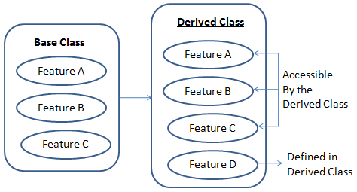
Internship 2020 .NET: POO Concepts - 1. Inheritance
dsgdfghgjf
Inheritance
enables you to create new classes that reuse, extend, and modify the behavior defined in other classes. The class whose members are inherited is called the base class, and the class that inherits those members is called the derived class.
Notes:
Inheritance docs:
https://docs.microsoft.com/en-us/dotnet/csharp/programming-guide/classes-and-structs/inheritance
http://net-informations.com/faq/oops/inheritance.htm
Safely cast:
https://docs.microsoft.com/en-us/dotnet/csharp/how-to/safely-cast-using-pattern-matching-is-and-as-operators
Object initialization:
http://www.csharp411.com/c-object-initialization/

Slide 5
Internship 2020 .NET: POO Concepts - 1. Inheritance
dsgdfghgjf
Inheritance types
ClassA
ClassA
ClassA
ClassB
ClassB
ClassB
ClassC
1. Single
3. Hierarchical
ClassC
2. Multilevel
Multiple and hibrid inheritance types are not supported in .NET
Notes:
Inheritance docs:
https://docs.microsoft.com/en-us/dotnet/csharp/programming-guide/classes-and-structs/inheritance
http://net-informations.com/faq/oops/inheritance.htm
Safely cast:
https://docs.microsoft.com/en-us/dotnet/csharp/how-to/safely-cast-using-pattern-matching-is-and-as-operators

Slide 6
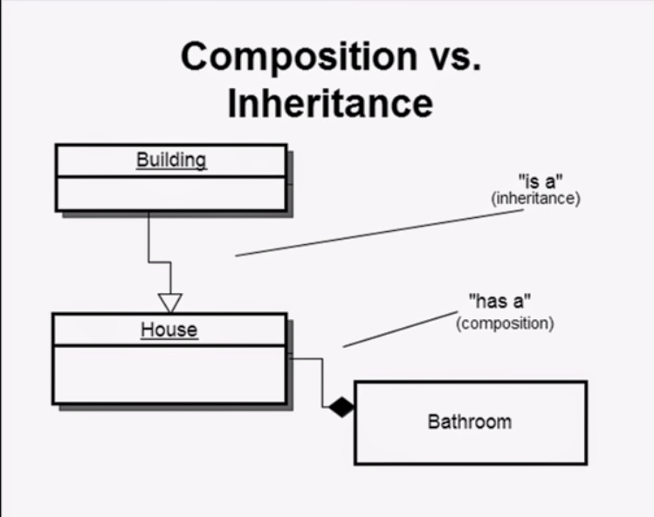
Internship 2020 .NET: POO Concepts - 1. Inheritance
Best Practices
Inheritance (IS-A) vs. Composition (HAS-A) Relationship
Notes:
https://www.c-sharpcorner.com/blogs/isa-versus-hasa1

Slide 7
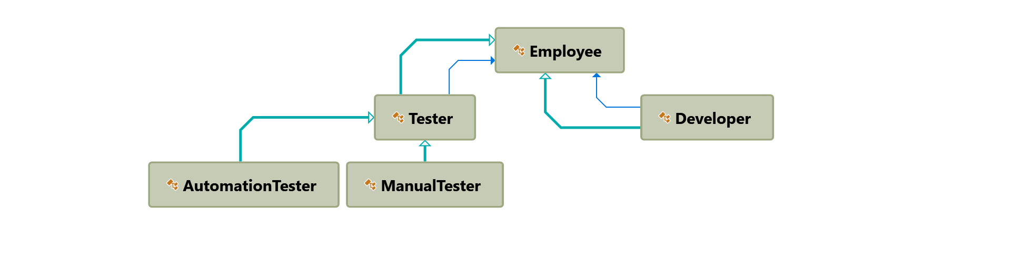
Internship 2020 .NET: POO Concepts - 1. Inheritance
dsgdfghgjf
Inheritance example
Notes:
https://gitlab.endava.com/Ionela.Hurjui/pooconcepts

Slide 8
2
Internship 2020 .NET: POO Concepts
Abstract classes

Slide 9
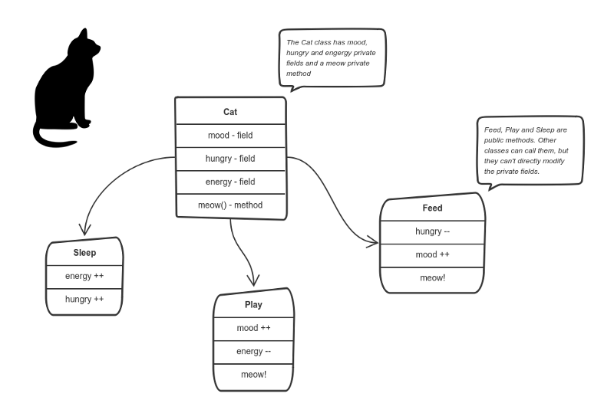
Internship 2020 .NET: POO Concepts
dsgdfghgjf
Encapsulation
Encapsulation is achieved when each object keeps its state private, inside a class. Other objects don’t have direct access to this state. Instead, they can only call a list of public functions — called methods.
Encapsulate all “cat” logic into a Cat class. It may look like this:

Slide 10
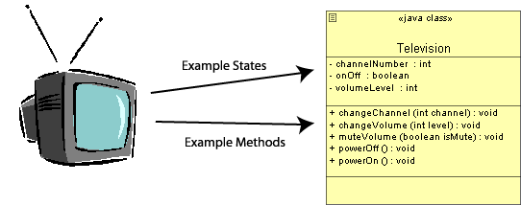
Internship 2020 .NET: POO Concepts - 2. Abstract classes
dsgdfghgjf
Abstraction
Data abstraction is the process of hiding certain details and showing only essential information to the user. Abstraction can be achieved with either abstract classes or interfaces.
An abstract class is a class that is incomplete, in that it describes a set of operations, but is missing the actual implementation of these operations.
The abstract keyword is used for classes and methods:
Abstract class: is a restricted class that cannot be used to create objects (to access it, it must be inherited from another class).
Abstract method: can only be used in an abstract class, and it does not have a body. The body is provided by the derived class (inherited from).

Slide 11
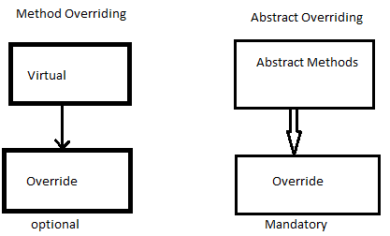
Internship 2020 .NET: POO Concepts - 2. Abstract classes
dsgdfghgjf
Abstract vs Virtual Methods
Abstract Method:
If an abstract method is defined in a class, then the class should declare as an abstract class.
An abstract method should contain only method definition, should not Contain the method body/implementation.
An abstract method must be override in the derived class.
Virtual Method:
Virtual methods can be override in the derived class but not mandatory.
Virtual methods must have the method body/implementation along with the definition.

Slide 12
3
Internship 2020 .NET: POO Concepts
Interfaces

Slide 13
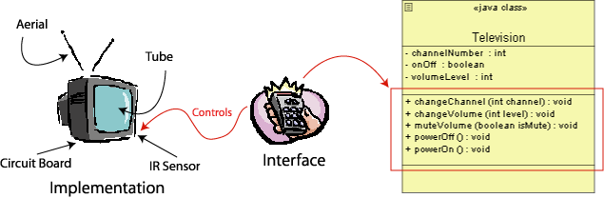
Internship 2020 .NET: POO Concepts - 3. Interfaces
dsgdfghgjf
Interfaces
Another way to achieve abstraction in C#, is with interfaces.
An interface is a completely "abstract class", which can only contain abstract methods and properties (with empty bodies)

Slide 14
Internship 2020 .NET: POO Concepts - 3. Interfaces
dsgdfghgjf
Interfaces
Notes on Interfaces:
Like abstract classes, interfaces cannot be used to create objects (in the example above, it is not possible to create an "IAnimal" object in the Program class)
Interface methods do not have a body - the body is provided by the "implement" class
On implementation of an interface, you must override all of its methods
Interfaces can contain properties and methods, but not fields/variables
Interface members are by default abstract and public
An interface cannot contain a constructor (as it cannot be used to create objects)
An interface can extends one or more interfaces
A class can implement one or more interfaces

Slide 15
Internship 2020 .NET: POO Concepts - 3. Interfaces
dsgdfghgjf
Interfaces
Why And When To Use Interfaces?
1) To achieve security - hide certain details and only show the important details of an object (interface).
2) C# does not support "multiple inheritance“.
It can be achieved with interfaces, because the class can implement multiple interfaces.

Slide 16
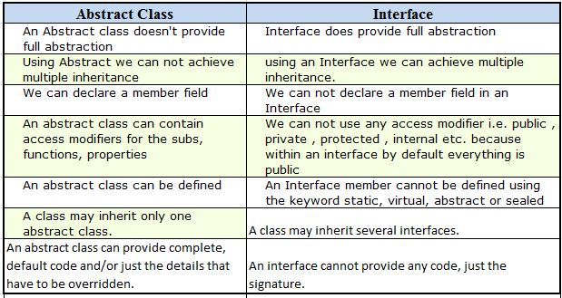
Internship 2020 .NET: POO Concepts - 3. Interfaces
dsgdfghgjf
Interface vs Abstract class

Slide 17
4
Internship 2020 .NET: POO Concepts
Polymorphism

Slide 18
Internship 2020 .NET: POO Concepts - 4. Polymorphism
dsgdfghgjf
Polymorphism
Polymorphism
It is a Greek word poly which means many, and morphism means forms. In simple words, it gives the ability to a class to have multiple definitions for a function/method with the same name.
Static Polymorphism
Dynamic Polymorphism
Overloading
Overriding
Notes:
https://docs.microsoft.com/en-us/dotnet/csharp/programming-guide/classes-and-structs/polymorphism
https://dotnettutorials.net/lesson/polymorphism-csharp/

Slide 19
Internship 2020 .NET: POO Concepts - 4. Polymorphism
dsgdfghgjf
Overloading
Method Overloading
You can have multiple definitions for the same function name in the same scope. The definition of the function must differ from each other by the types and/or the number of arguments in the argument list. You cannot overload function declarations that differ only by return type.
Operator Overloading
A user-defined type can overload a predefined C# operator. That is, a type can provide the custom implementation of an operation in case one or both of the operands are of that type.
Notes:
Method overloading:
https://dotnettutorials.net/lesson/function-overloading-csharp/
Operator overloading:
https://docs.microsoft.com/en-us/dotnet/csharp/language-reference/operators/operator-overloading

Slide 20
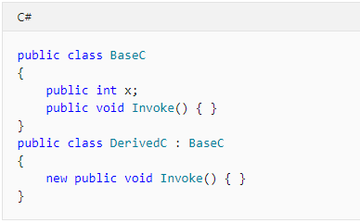
Internship 2020 .NET: POO Concepts - 4. Polymorphism
dsgdfghgjf
New Modifier
When used as a declaration modifier, the new keyword explicitly hides a member that is inherited from a base class.
Notes:
https://docs.microsoft.com/en-us/dotnet/csharp/language-reference/keywords/new-modifier

Slide 21
Internship 2020 .NET: POO Concepts - 4. Polymorphism
dsgdfghgjf
Practice
{
"developers":[
{
"Id":1,
"Name":"Ion",
"Level":"Senior developer",
"HourlyRate":30.5,
"WorkingHours":160
},
{
"Id":2,
"Name":"Vasile",
"Level":"Junior developer",
"HourlyRate":20,
"WorkingHours":150
},
{
"Id":3,
"Name":"Luca",
"Level":"Senior developer",
"HourlyRate":30.5,
"WorkingHours":190
},
{
"Id":4,
"Name":"Petru",
"Level":"Junior developer",
"HourlyRate":20,
"WorkingHours":140
},
{
"Id":5,
"Name":"Pavel",
"Level":"Senior developer",
"HourlyRate":30.5,
"WorkingHours":180
}
]
}
You have a task where you need to calculate the total cost of all the developer salaries in a single company.
Your boss comes to your office and says that he need a different calculation for the senior and junior developers. The senior developers should have a bonus of 20% on a salary.
You need to have 5 salary reports for different type of developers(junior and senior) and to calculate the total cost of all the developers.
Note: The salary for one employee is calculated in this way:
Salary = WorkingHours * HourlyRate
public class DeveloperReport
{
public int Id { get; set; }
public string Name { get; set; }
public string Level { get; set; }
public int WorkingHours { get; set; }
public double HourlyRate { get; set; }
}

